Slide 1
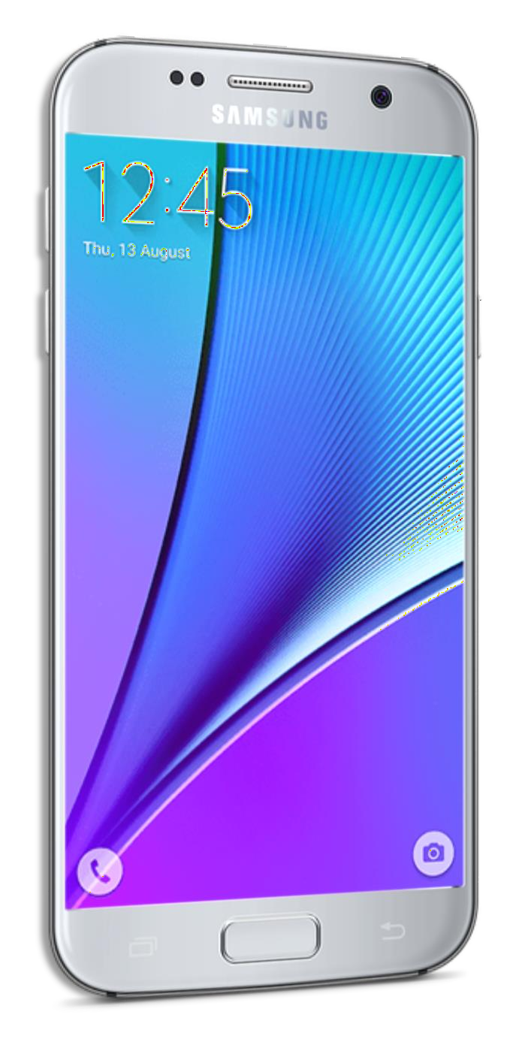
LECTURE - 01
MOBILE APPLICATION DEVELOPMENT

Slide 2
Chapter 1: Introduction
1.1 Introduction to Mobile Computing

Slide 3
Definition
Mobile computing refers to the ability to use computing capabilities without being confined to a single physical location.
It allows users to access data, applications, and services via portable devices like smartphones, tablets, and laptops.

Slide 4
Components of Mobile Computing
Mobile Hardware: Includes smartphones, tablets, laptops, wearables (smartwatches, fitness trackers), and IoT devices.
Mobile Software: Operating systems (Android, iOS, Windows Mobile), apps, middleware, and firmware that run on mobile devices.
Mobile Communication: Involves wireless protocols and technologies like Wi-Fi, 4G/5G, Bluetooth, and NFC, which enable mobile devices to connect and exchange data over networks.

Slide 5
History and Evolution
Early Mobile Devices: Began with personal digital assistants (PDAs) and evolved into today’s smartphones and tablets.
Smartphones and Tablets: Revolutionized mobile computing with devices like the iPhone in 2007.
Wearables and IoT: Wearables like smartwatches and IoT devices expand mobile computing.

Slide 6
Advantages of Mobile Computing
Mobility: Users can perform tasks anytime and anywhere.
Connectivity: Constant access to data and information through wireless networks.
Flexibility: Various mobile applications for communication, work, learning, and entertainment.

Slide 7
Challenges of Mobile Computing
Security Risks: Susceptibility to threats like data breaches, malware, and theft.
Battery Life: Limited power supplies for mobile devices.
Performance: Lower computational power compared to desktops.

Slide 8
Applications of Mobile Computing
Personal Use: Messaging, social media, navigation, mobile banking, fitness tracking.
Business Use: Mobile workforces, cloud services, inventory management, and marketing.
Healthcare: Remote monitoring, telemedicine, and mobile health apps.
Education: Mobile learning platforms, educational apps, and distance learning.

Slide 9
1.2 Introduction to Android Development Environment

Slide 10
What is Android?
Android OS: An open-source operating system developed by Google for mobile devices.
Android Features: Multitasking, customizable UI, notifications, connectivity, multi-language support.

Slide 11
Android Architecture
Linux Kernel: Core services such as memory management, process management, and hardware abstraction.
Libraries: Includes core libraries for graphics (OpenGL), databases (SQLite), and web (WebKit).
Android Runtime (ART): Environment for apps, including the Dalvik Virtual Machine and core Java libraries.
Application Framework: Key services for apps, such as Activity Manager and Notification Manager.
Applications: The top layer, where Android apps run.

Slide 12
Setting Up Android Development Environment
Android Studio: The official IDE for Android, based on IntelliJ IDEA.
SDK Manager: Used to download and manage SDK packages for Android versions.
Gradle Build System: Manages dependencies, compiles code, and builds APKs.
Android Emulator: Allows testing on virtual devices with different configurations.

Slide 13
Core Android Components
Activities: Represents a single screen in the app.
Services: Background tasks running without a user interface.
Broadcast Receivers: Responds to system-wide events like battery low.
Content Providers: Manages shared data between apps.

Slide 14
Programming Languages for Android
Java: The original language for Android, still widely used.
Kotlin: Officially preferred language since 2017, interoperable with Java.

Slide 15
Building and Running Android Apps
Compiling Apps: Uses Gradle to compile code into APKs.
Testing: Apps can be tested using Android Emulator or physical devices.

Slide 16
WHAT IS ANDROID?
Mobile operating system based on Linux Kernel
User Interface for touch screens
Used on over 80% of all smartphones
Powers devices such as watches, TVs, and cars
Over 2 Million Android apps in Google Play store
Highly customizable for devices / by vendors
Open source

Slide 17
IDE (Integrated Development Environment)
Software suite that consolidates basic tools required to write and test software.
Without an IDE, a developer must select, deploy, integrate and manage all of these tools separately.
An IDE can be a standalone application or it can be part of a larger package.
For example:
Net beans, Eclipse, Android Studio

Slide 18
JDK (Java Development Kit)
The JDK is one of three core technology packages used in Java programming, along with the JVM (Java Virtual Machine) and the JRE (Java Runtime Environment).
The JVM is the Java platform component that executes programs.
The JRE is the on-disk part of Java that creates the JVM.
The JDK allows developers to create Java programs that can be executed and run by the JVM and JRE.

Slide 19
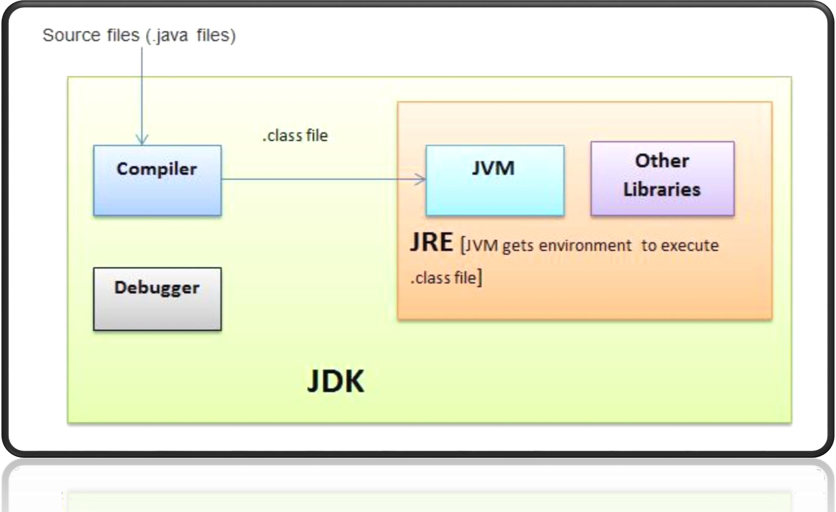
JDK - JRE - JVM

Slide 20
AVD (Android Virtual Device)
AVD is an emulator configuration that allows developers to test the application by simulating the real device capabilities.
We can configure the AVD by specifying the hardware and software options.
AVD manager enables an easy way of creating and managing the AVD with its graphical interface

Slide 21
LIBRARY
It can include everything needed to build an app, including source code, resource files, and an Android manifest.
Complete package of something
For example:
Photo manipulation in android.
Write code of scaling and animating for every time ☹
“Picasso” photo manipulating library

Slide 22
API (Application Programming Interface)
API is a software intermediary that allows two applications to talk to each other
Connectivity with server and hardware
For Example:
Waiter in a hotel
Each time you use an app like Facebook, send an instant message, or check the weather on your phone, you’re using an API.
Use Google map
Book different flights from different sites

Slide 23
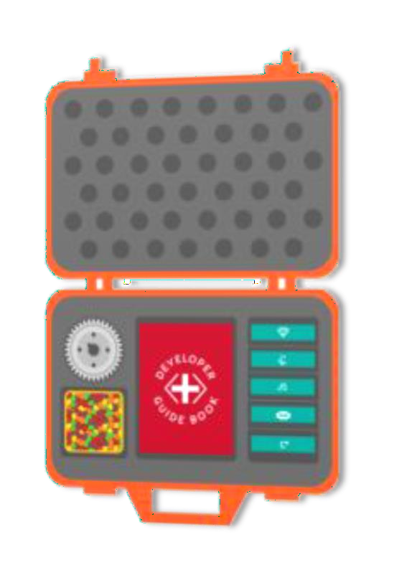
SDK (Software Development Kit)
SDK or devkit, providing a set of tools, libraries, relevant documentation, code samples, processes, and or guides that allow developers to create software applications on a specific platform.
For Example:
Build a house without tools
For eat bread… seed…grow…harvest…eat ☹
Write your own code from scratch ☹

Slide 24

ANDROID OLDER VERSIONS
No | Name | Version | Released | API level
1 | Alpha | 1.0 | Sep 23, 2008 | 1
2 | Beta | 1.1 | Feb 09, 2009 | 2
3 | Cupcake | 1.5 | Apr 27, 2009 | 3
4 | Donut | 1.6 | Sep 15, 2009 | 4
5 | Éclair | 2.0 – 2.1 | Oct 26, 2009 | 5 – 7
6 | Froyo | 2.2 – 2.2.3 | May 20, 2010 | 8
7 | Gingerbread | 2.3 – 2.3.7 | Dec 06, 2010 | 9 – 10
8 | Honeycomb | 3.0 – 3.2.6 | Feb 22, 2011 | 11 – 13
9 | Ice-cream Sandwich | 4.0 – 4.0.4 | Oct 18, 2011 | 14 - 15

Slide 25
ANDROID OLDER VERSIONS
No | Name | Version | Released | API level
10 | Jelly Bean | 4.1 – 4.3.1 | Jul 09, 2012 | 16 – 18
11 | Kit Kat | 4.4 – 4.4.4 | Oct 31, 2013 | 19 – 20
12 | Lollipop | 5.0 – 5.1.1 | Nov 12, 2014 | 21 – 22
13 | Marshmallow | 6.0 – 6.0.1 | Oct 05, 2015 | 23
14 | Nougat | 7.0 – 7.1.2 | Aug 22, 2016 | 24 – 25
15 | Oreo | 8.0 – 8.1 | Aug 21, 2017 | 26 – 27
16 | Pie | 9.0 | Aug 06, 2018 | 28
17 | Android X | 9.0- | Sep, 2019 | 28-

Slide 26
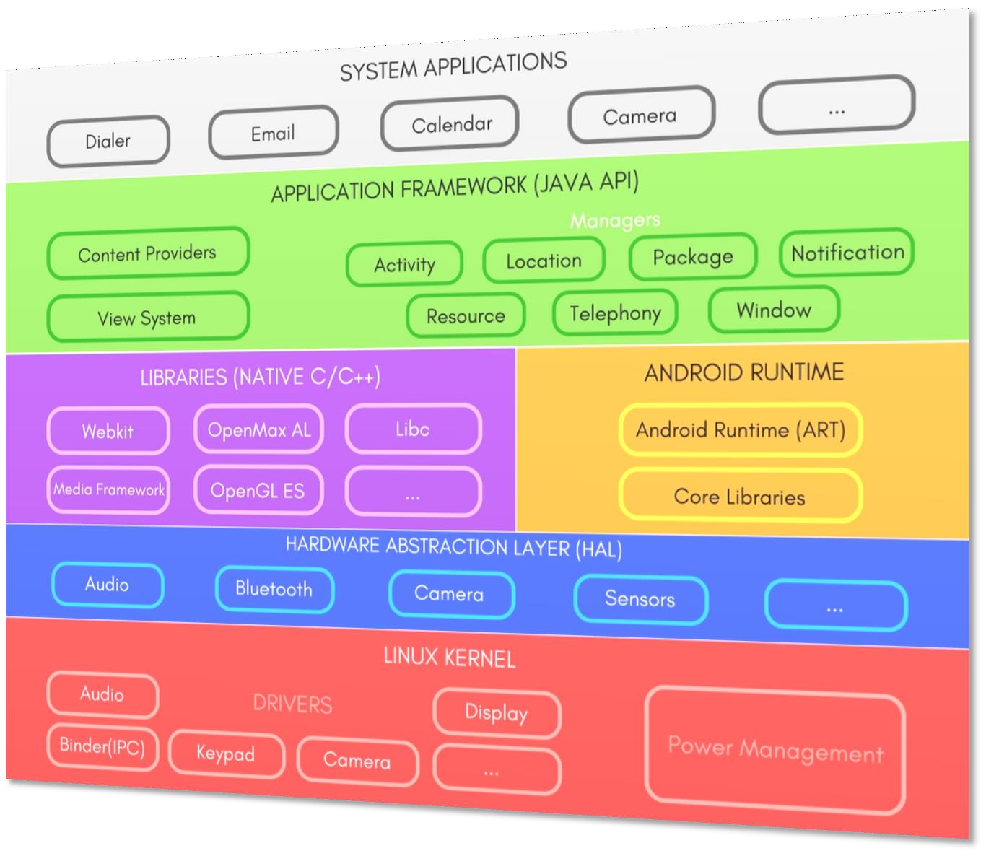
ANDROID PLATFORM ARCHITECTURE
Linux Kernel
HAL
ART
Libraries
Application Framework
System Applications

Slide 27
LINUX KERNEL
This layer is the foundation of the Android Platform.
Contains all low level drivers for various hardware components support.
Android Runtime relies on Linux Kernel for core system services like,
Memory, process management, threading etc.
Network stack
Driver model
Security and more.

Slide 28
HARDWARE ABSTRACTION LAYER
Provides Abstraction between hardware and rest of the software stack.

Slide 29
ANDROID RUNTIME (ART)
Designed to run apps in a constrained environment that has limited muscle power in terms of battery, processing and memory.
Contains set of core libraries that enables developers to write Android Apps using Java Programming.
It also has a very efficient garbage collection.

Slide 30
APPLICATION FRAMEWORK
It is a collection of APIs written in Java, which gives developers access to the complete feature set of Android OS.
Enables and simplify the reuse of core components and services, like:
Activity Manager:
Manages the Lifecycle of apps & provide common navigation back stack.
Window Manager:
Manages windows and drawing surfaces, and is an abstraction of the surface manager library.
Content Providers:
Enables application to access data from other applications or to share their own data

Slide 31
APPLICATION FRAMEWORK
View System:
Contains User Interface building blocks used to build an application's UI, including lists, grids, texts, boxes, buttons, etc. and also performs the event management of UI elements.
Package Manager:
Manages various kinds of information related to the application packages that are currently installed on the device.
Telephony Manager:
Enables app to use phone capabilities of the device.

Slide 32
APPLICATION FRAMEWORK
Resource Manager:
Provides access to non-code resources (localized Strings, bitmaps,
Graphics and Layouts).
Location Manager:
Deals with location awareness capabilities.
Notification Manager:
Enable apps to display custom alerts in the status bar.

Slide 33
SYSTEM APPLICATION
Top of the Android Application Stack, is occupied by the System apps and other Apps that users can download from Android's Official Play Store, also known as Google Play Store.
A set of Core applications are pre-packed in the handset like Email Client, SMS Program, Calendar, Maps, Browser, Contacts and few more.
This layer uses all the layers below it for proper functioning of these
mobile apps.

Slide 34
Installation of ANDROID STUDIO

Slide 35
THANK YOU ☺

